Slide 1
HTML & CSS
Review & Lab 2

Slide 2
Common XHTML Tags
BLOCK LEVEL (by default)
<h2>headings: h1-h6</h2>
<p>paragraph</p>
<div>text </div>
Lists:
<ul><li>bullets</li><ul>
<ol><li>numbered</li></ul>
These are all you require for Lab2's <body>.
(...and use the web!)
INLINE (by default)
<span>text</span>
<em>emphasis</em>
<strong>strong</strong>
<a href="uri">text</a>
ATTRIBUTES ID and CLASS
<div id="somename">…</div>
<div class="another">…</div>
<p class="repeatMe">…</p>
<span class="meToo">…</span>

Slide 3
XHTML Document
<!DOCTYPE html PUBLIC "-//W3C//DTD XHTML 1.0 Strict//EN" "http://www.w3.org/TR/xhtml1/DTD/xhtml1-strict.dtd">
<html xmlns="http://www.w3.org/1999/xhtml" xml:lang="en" lang="en">
<head>
<meta http-equiv="Content-Type" content="text/html; charset=UTF-8"/>
<title>a title for the document</title>
</head>
<body>
<div id="content">
<h1>Heading for this Page</h1>
<div class="someBox">
<p>First paragraph in "someBox" with <a href="uri">a link</a>.</p>
</div>
</div>
</body>
</html>
Notes:
-The DOCTYPE absolutely has to be the first thing in your XHTML document. After the DOCTYPE comes the HTML element. The HTML element wraps around all of your content. It basically says, "Hey, HTML coming through!”
-Inside of the HTML element, every XHTML document must have two main parts: the head and the body. The content in the HEAD element does not display in the main browser window. Instead it tells the browser crucial information about the web page, such as where the CSS is located, and what the title of the web page is.
-The title element denotes the title for the document. This is the information that gets displayed in the browser's title bar. It does not display in the browser window, though it is useful for search engines.
-The body is where all of our displayed content will be written. It comes right after the HEAD element closes.
Source: http://desource.uvu.edu/dgm/2120/in/steinja/lessons/03/03_04.html

Slide 4
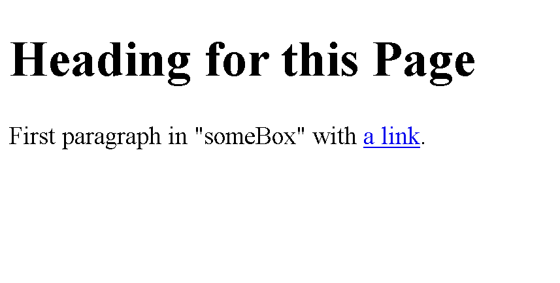
XHTML Document, Rendered:
Notes:
Example - XHMTL code Style Example
HTML&CSSReview&Lab2-Ex1-Pg4.html

Slide 5
XHTML Document, Rendered:
Notes:
Show Example

Slide 6
IDs and Classes
An "id" is a unique identifier for an element
<div id="footer"></div>
A "class" is a non-unique identifier for an element
<div class="rightCallOut"></div>

Slide 7
Some CSS Properties
width
margin
padding
border
color
background-color
font-family
font-size
font-variant
display
float
clear
white-space
text-align (tip: this only works inside blocks)
list-style
It is possible to accomplish Lab2 using only these -- but you don't have to use them all or be limited to them either.

Slide 8
HTML/CSS Example
#footer { border-top: 1px solid black; padding: 0.5em 1em 1em 1em; color: #333; background-color: #eee; } #footer a:hover { font-weight: bold; font-style: italic; } em { color: red; }
<div id="footer">
<a href="somepage.html">
This link will be <em>styled</em>
on a mouse hover
</a>
</div>
Notes:
Show Pg 8 example
HTML&CSSReview&Lab2-Ex2-Pg8.html

Slide 9
Selectors
HTML like this | might be selected like this
ID selectors
<div id="header"></div> | #header {}
<h2 id="mainTitle"></h2> | h2#mainTitle {}
class selectors
<p class="green"></p> | .green {}
<li class="selected"></li> | li.selected {}
element selectors
<p class="green"></p> | p {}
<h1></h1> | h1 {}
<p><strong>hi</strong></p> | p strong {}
See http://www.w3.org/TR/CSS2/selector.html

Slide 10
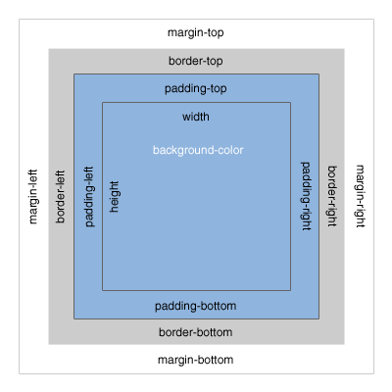
CSS Box Model
[Untitled graphic of the CSS Box Model, Bitmap]. Retrieved September 10 from http://www.mandalatv.net/itp/drivebys/css/

Slide 11
Floating Elements
An element may be floated left or right (or not at all, which is default)
.pullQuote { float: right; clear: right; width: 100px; }
"A pull quote is a good example."
Notes:
Pg 11 ex 3
HTML&CSSReview&Lab2-Ex3-Pg11.html

Slide 12
paragraph
float right
paragraph
Notes:
Remember – in the box model, the total width is the sum of the width, padding, border ….

Slide 13
Where to go for help...
Search the web! (A search engine is your friend.)
Try W3Schools:
Particularly for its references
http://www.w3schools.com/
Try other sites too
https://tutsplus.com/lesson/the-box-model/
http://webdesign.tutsplus.com/tutorials/workflow-tutorials/faster-htmlcss-workflow-with-chrome-developer-tools/
View page source! Look at CSS files.
The web is open – learn from others

Slide 14
XHTML Code Style
Correct XHTML example:
<!-- output news block --> <div id="news"> <h3>Latest News</h3> <ul> <li>Item 1</li> <li>Item 2</li> </ul> </div>

Slide 15
CSS Code Style
Correct CSS example:
ul#header li { float: left; width: 100px; background-color: #F0EEE5; color: black; }
/* highlight the selected tab */ ul#header li.selected { background-color: #000; color: white; }
Notes:
Page 15 ex 4
HTML&CSSReview&Lab2-Ex4-Pg15.html

Slide 16
Some Tips
Think of layout in terms of boxes on a page (we'll do some examples of this together as part of Lab2)
Floated elements typically require explicit widths to work as you expect them to work.
How to center a block relative to the page?
Use margin:
#someBlock { margin: 1em auto 2em auto; } /*or maybe just "margin: auto" */
Notes:
Page 16 ex 5
HTML&CSSReview&Lab2-Ex5-Pg16.html

Slide 17
Lab 2 - HTML & CSS
Learn by doing:
You are to create a resume
I’ve provided you a starting HTML template
We will work through some of this together in class
Feel free to experiment and be creative (but show us that you can create something similar to the example resume)
This will be due end of day on Monday. See the lab in the LMS for more specifics.

Slide 18
Layout Blocking
browser window
(body)
top-level block
header of some kind?
more blocks inside another block

